Slide 1
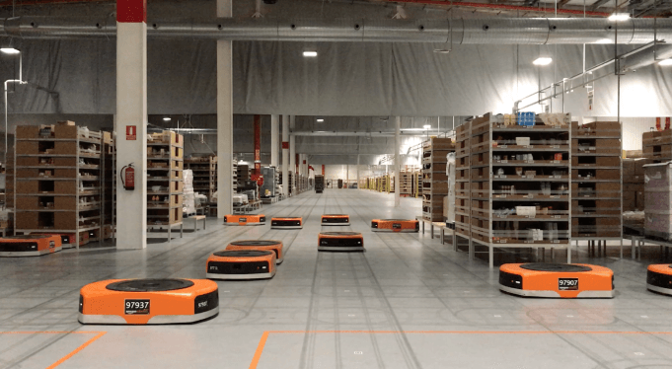
Amazon Robotics machines in a Amazon warehouse
Collision avoidance and coordination for a fleet of robots
Luca Marseglia

Slide 2
Optimizing execution time
The execution time for the optimization was too slow.
These parameters will be used as a benchmark:
Reduced Brute-force Approach | Genetic Algorithm
 | Single-objective |  | Multi-objective
Prioritized planning
 | Maximum velocities | Slow-down segment | Slow-down segment
1000 individuals
100 generations
93 minutes
2024 October | Slide 2

Slide 3
Optimizing execution time
The problem relies in the constraints verification for the optimization: at each generation the program needs to check the violation of the constraints. To do this, the interpolation is performed several times.
To speed up interpolation, two subsequent optimizations of the code have been performed:
First optimization:
Reduction of the number of samples
Vectorization of the for cycles when checking the minimum distances between two robots
Second optimization:
Manual derivation of the polynomials to get velocity and acceleration (the «fnder» method offered by matlab is too slow)
Manual implementation of the polynomials evaluation in C code and pre-compilation of the function into a MEX-file for faster execution (the «ppval» method offered by matlab is too slow)
2024 October | Slide 3

Slide 4
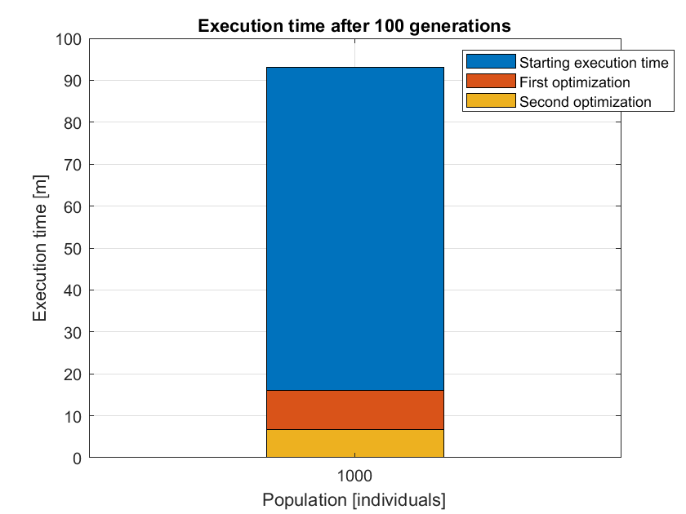
Result
2024 October | Slide 4

Slide 5
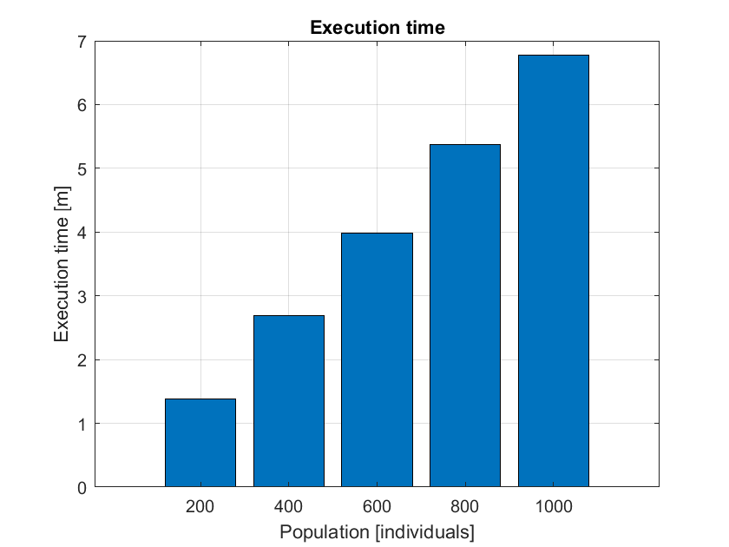
Detailed execution times
2024 October | Slide 5

Slide 6
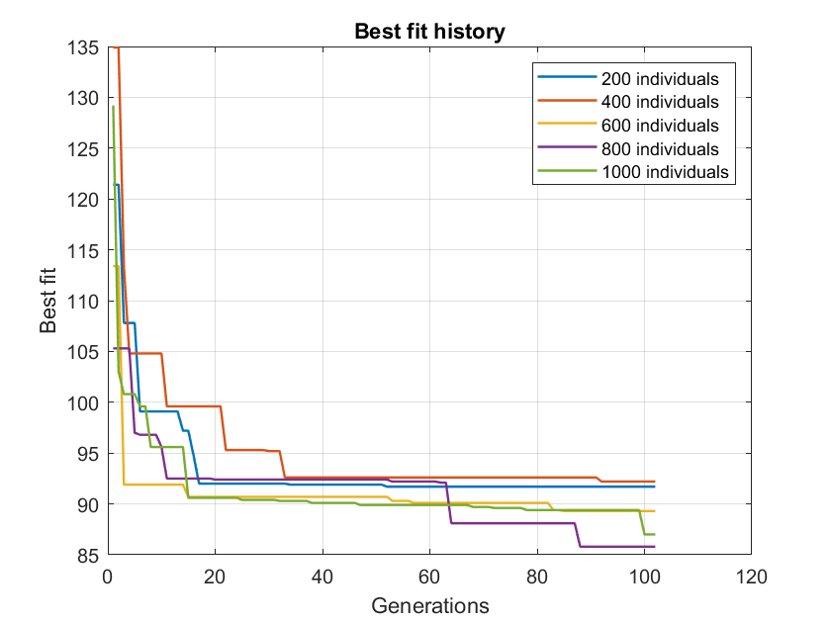
Best fit histories
2024 October | Slide 6

Slide 7
7 robots
1000 individuals
100 generations
Execution times
Reduced Brute-force Approach 80 min | Genetic Algorithm
 | Single-objective |  | Multi-objective
Prioritized planning 1.15 s
 | Maximum velocities 10 min | Slow-down segment 7 min | Slow-down segment 9 min
2024 October | Slide 7

Slide 8
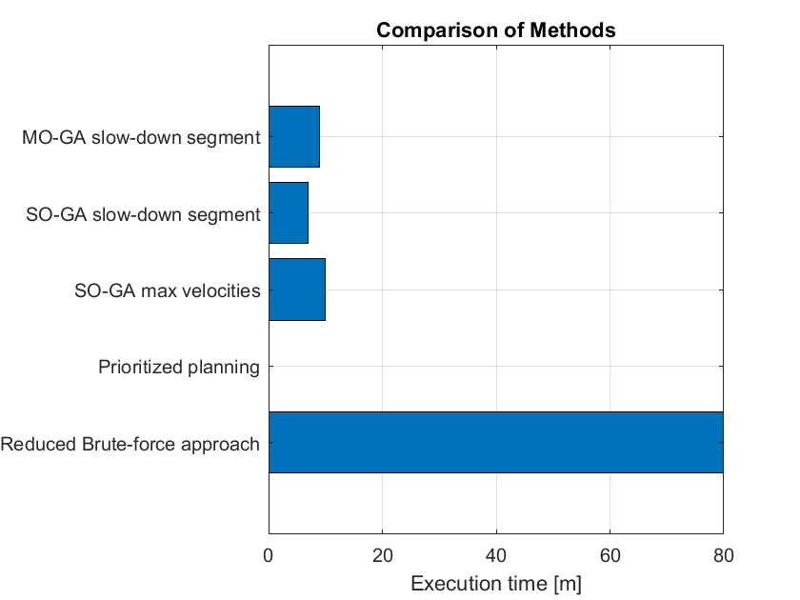
Execution times
1000 individuals
100 generations
2024 October | Slide 8

Slide 9
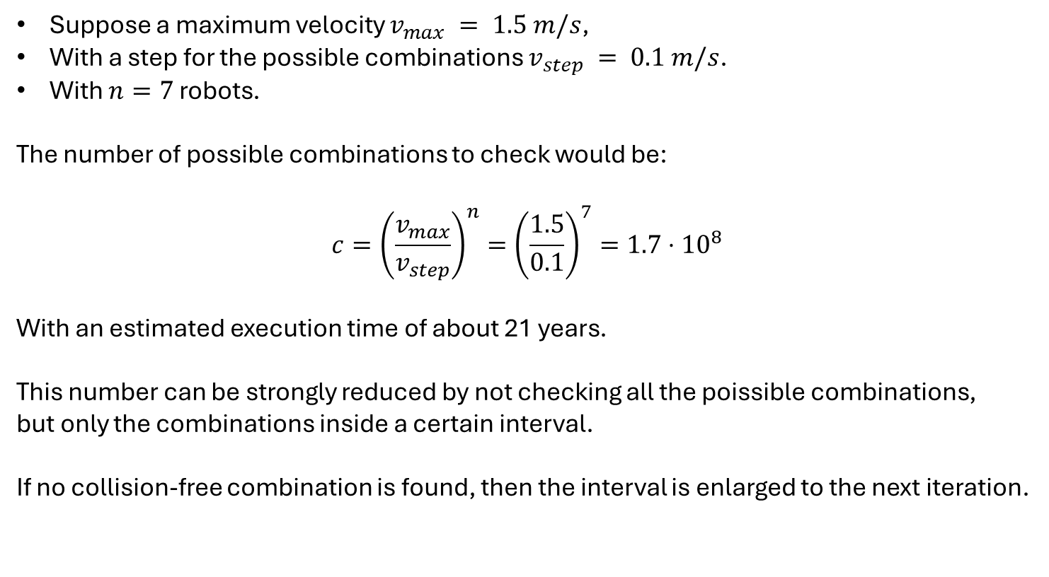
Reduced Brute-force approach
Suppose a maximum velocity $v_{max} = 1.5 m/s$,
With a step for the possible combinations $v_{step} = 0.1 m/s$.
With $n=7$ robots.
The number of possible combinations to check would be:
$$c={\left(\frac{v_{max}}{v_{step}}\right)}^{n}={\left(\frac{1.5}{0.1}\right)}^{7}=1.7⋅{10}^{8}$$
With an estimated execution time of about 21 years.
This number can be strongly reduced by not checking all the poissible combinations,
but only the combinations inside a certain interval.
If no collision-free combination is found, then the interval is enlarged to the next iteration.
2024 October | Slide 9

Slide 10
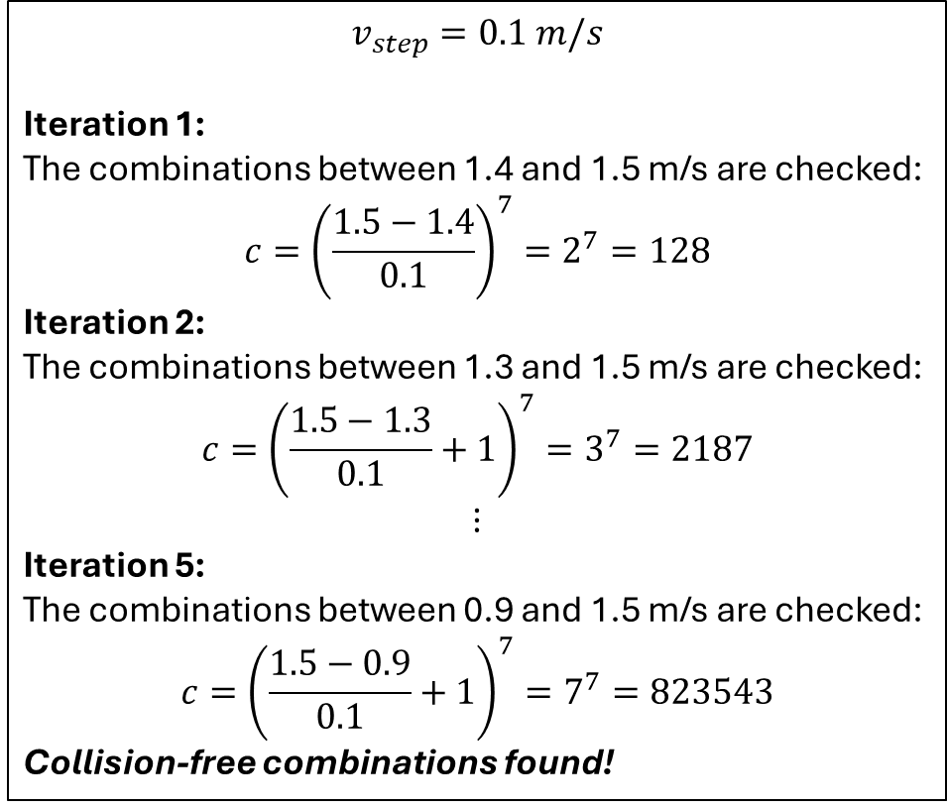
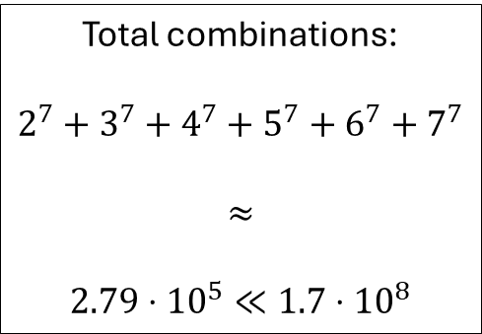
Reduced Brute-force approach
$$v_{step}=0.1 m/s$$
Iteration 1:
The combinations between 1.4 and 1.5 m/s are checked:
$$c={\left(\frac{1.5−1.4}{0.1}\right)}^{7}=2^{7}=128$$
Iteration 2:
The combinations between 1.3 and 1.5 m/s are checked:
$$c={\left(\frac{1.5−1.3}{0.1}+1\right)}^{7}=3^{7}=2187$$
$$⋮$$
Iteration 5:
The combinations between 0.9 and 1.5 m/s are checked:
$$c={\left(\frac{1.5−0.9}{0.1}+1\right)}^{7}=7^{7}=823543$$
Collision-free combinations found!
For example:
Total combinations:
$$2^{7}+3^{7}+4^{7}+5^{7}+6^{7}+7^{7}$$
$$≈$$
$$2.79⋅{10}^{5}≪1.7⋅{10}^{8}$$
2024 October | Slide 10

Slide 11
Issue: scalability
7 robots
14 robots
Finish time before optimization | 76.80 sec
Population | 1.000
Generations | 100
Execution time | 7m
Finish time after optimization | 87 sec (+13%)
Finish time before optimization | 98 sec
Population | 10.000
Generations | 100
Execution time | 2h 23m*
Finish time after optimization | 140.20 sec (+43%)
* If the population is not increased, the execution time is about 14 mins, twice as much as the case with 7 robots, but the results are much worse.
2024 October | Slide 11

